Slide 1

Seminar
on
Meter Reading Using Deep Learning
Presenter Supervisor
Harsh Gupta Dr. Nidhi Gupta
Roll No: 20MMA007 Assistant Professor
Department of Mathematics and Scientific Computing,
National Institute of Technology, Hamirpur, HP, India 177005
March 24, 2022

Slide 2
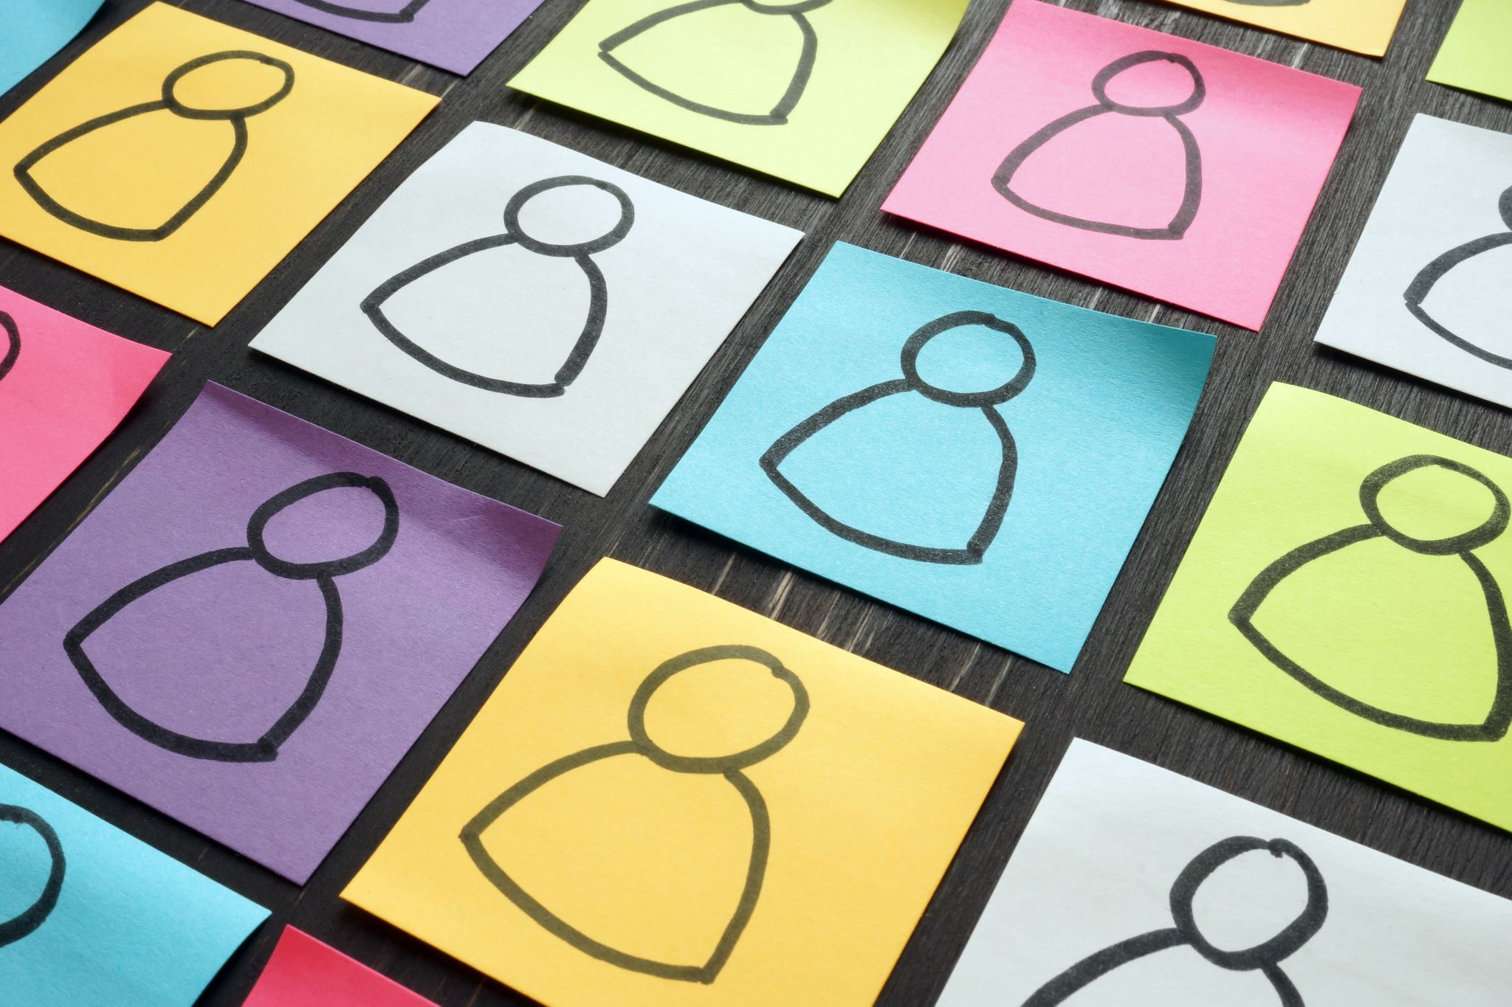
Overview
Introduction
Problem Statement
State of the Art
Methodology
Dataset/Experimental Setup
Solution Approach
Further Applications
References
Notes:
This ppt contains

Slide 3
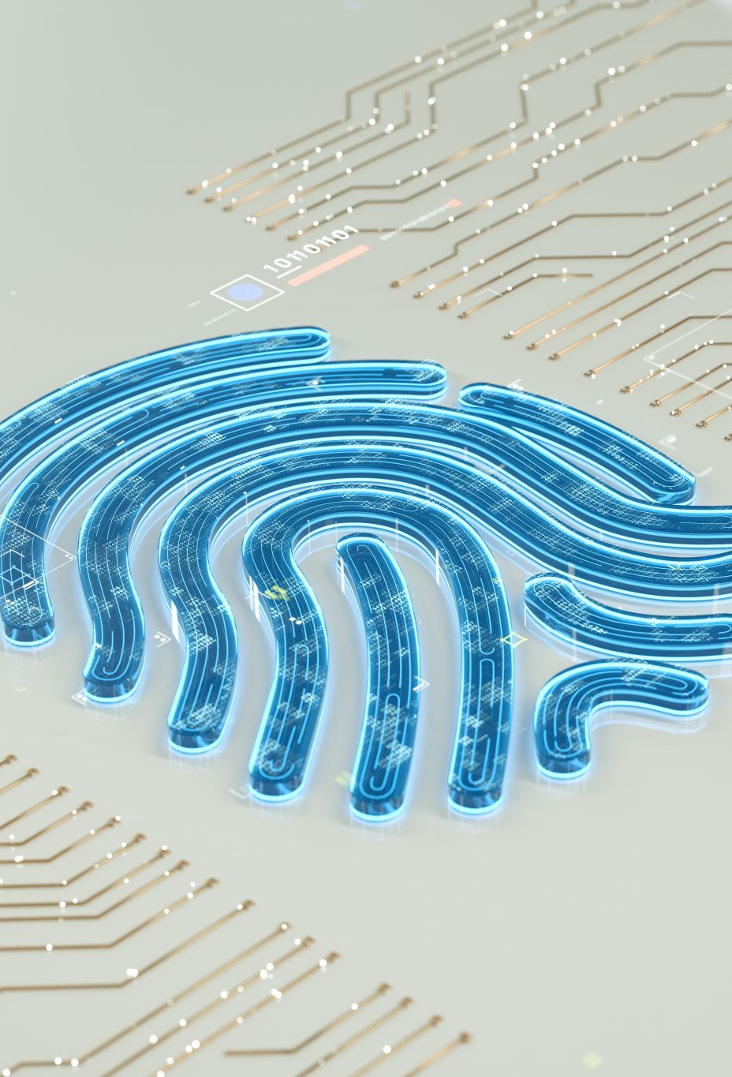
Introduction
Automatic Meter Reading (AMR) refers to the technology
whose goal is to automatically record the consumption
of electric energy, gas and water for both monitoring and
billing [1, 2]. Although smart meters are gradually replacing
old meters, in many regions (especially in developing
countries) the reading is still done manually in the field, on
a monthly basis, by an employee of the service company who
takes a picture as reading proof.
Notes:
for example, when the consumer makes a complaint about the amount charged and when the registered consumption differs significantly from that consumer’s average. This offline checking is known to be a laborious task

Slide 4
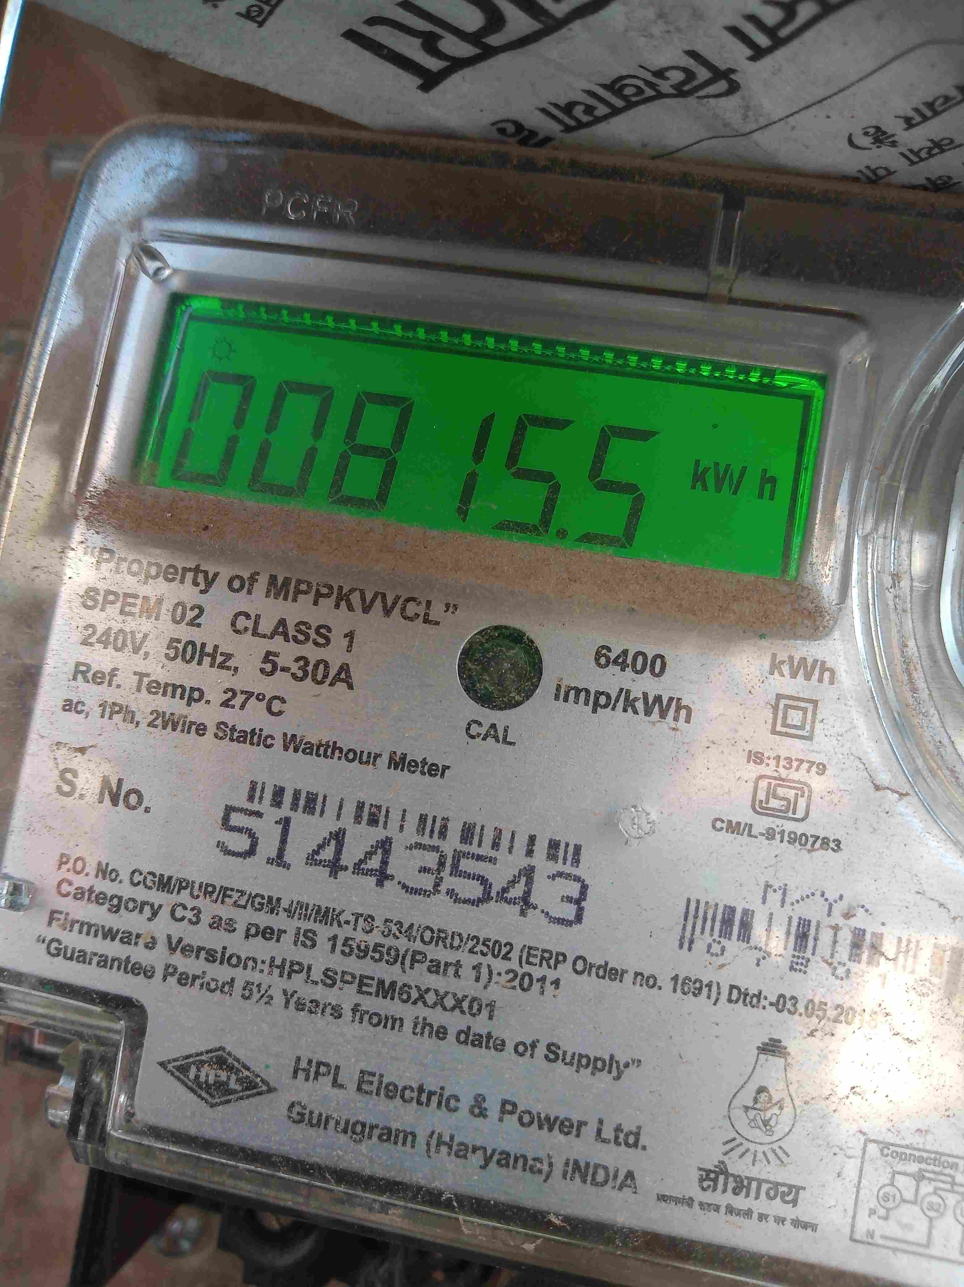



Problem Statement
What
Using Machine Learning Techniques to
Identify the Meter Reading from an Image.
Why
Manual meter reading is a time consuming,
error prone and hectic procedure.
How
By extending help in automating meter reading hence reducing time, effort and resources used.

Slide 5
State of the Art
R. Laroca et al. [1] approach consist of three main stages
First stage: Counter Detection
Second stage: Corner detection and counter classification
Third stage: Counter Recognition
Notes:
There are various work people have done in this area for example

Slide 6
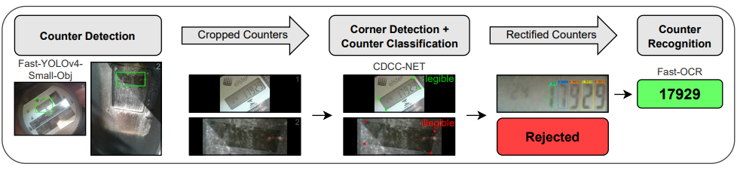
Method used
Notes:
The pipeline of the proposed AMR system. Given an input image, the counter region is located using a modified version of the Fast-YOLOv4 model. Then, in a single forward pass of the proposed CDCC-NET, the cropped counter is classified as legible/operational or illegible/faulty and the position (x, y) of each of its corners is predicted. Finally, illegible counters are rejected, whereas legible ones are rectified and fed into our recognition network, called Fast-OCR

Slide 7
State of the Art
Rayson Laroca et al uses two stage approach for AMR and used UFPR-AMR dataset.
Detect the counter region employs a smaller version of the YOLO object detector, called Fast-YOLO,14 for counter detection
Digit segmentation and recognition evaluate by three CNN-based approaches
CR-NET
Multi-Task Learning
Convolutional Recurrent Neural Network
Notes:
UFPR-AMR is a public dataset for AMR with 2,000 fully and manually annotated images/meters
CR-NET is a YOLO-based model proposed for license plate character detection and recognition
Multi-Task and CRNN are segmentation-free approaches designed respectively for the recognition of license plates and scene text

Slide 8
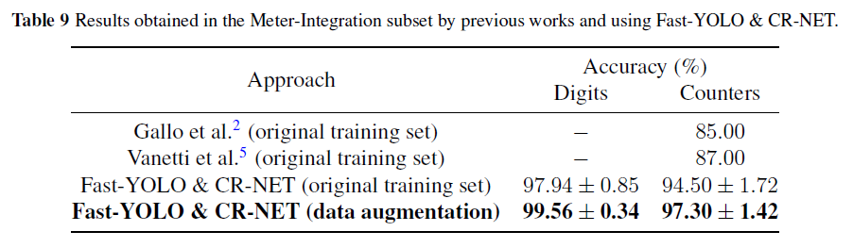
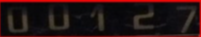
Method Used
[0 0 1 2 7]
Results obtained by the CR-NET
counter detection obtained with the Fast-YOLO model.

Slide 9
About Dataset
The AMR dataset(private) contains more than 10,000 images of meter readings.
The AMR dataset composed of images captured in unconstraint environment including blur (due to camera in motion), scale variation, reflections, shadows, occlusions etc.
The images have resolution of 3072 x 4096 or 2992 x 4000.
Initially, I have manually labelled 94 meter readings for training and testing.

Slide 10
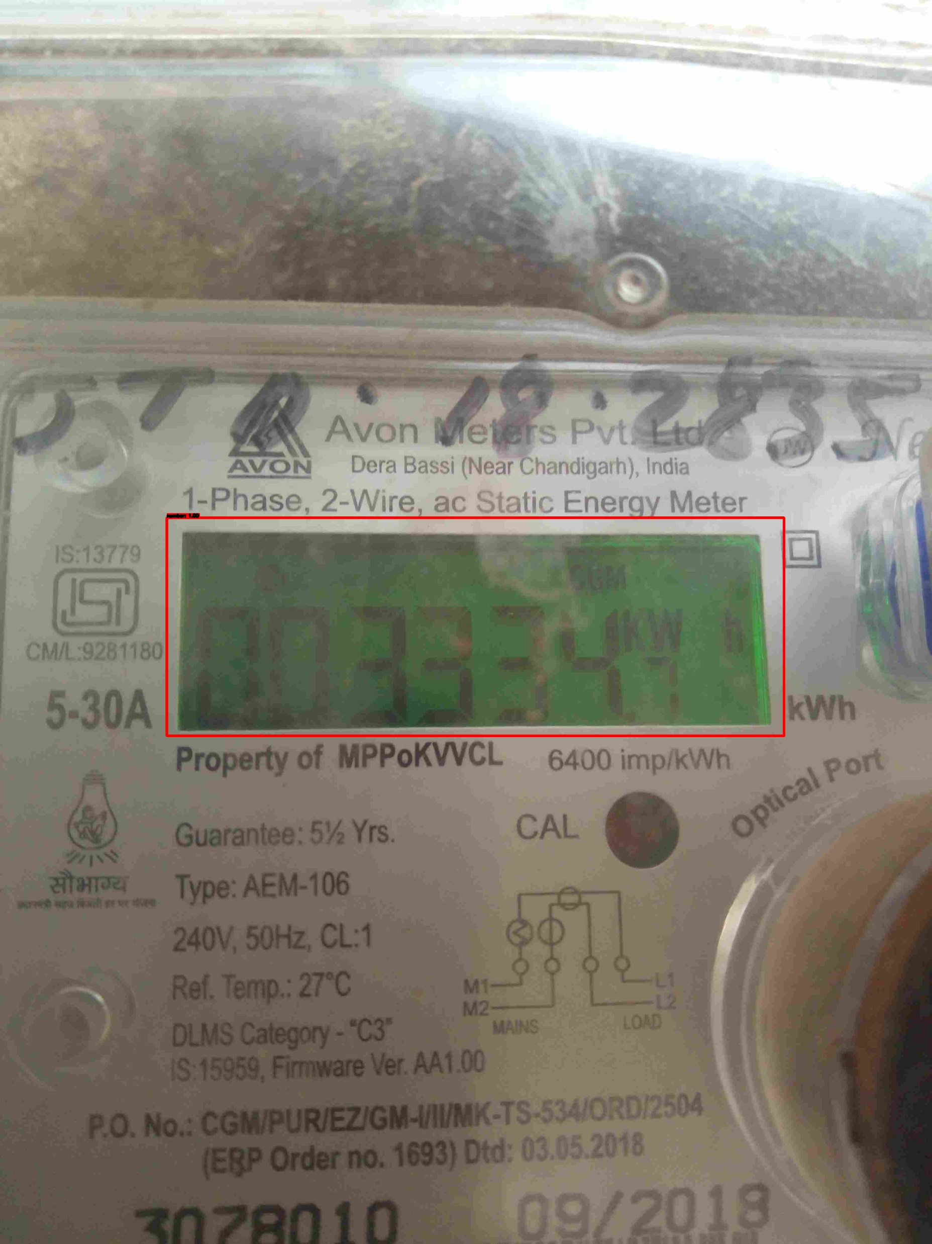
Preparing labelled dataset.
YOLO Darknet TXT Annotation Format:
[object_id, x_center, y_center, width, height]
where:
(<x_center> , <y_center>) : Coordinates of the center.
<width> : Normalized width.
<height> : Normalized height.
Image Labelling tools are:
MakeSense.ai
labelimg
Labelme
Roboflow
[0 0.562942 0.535336 0.388251 0.226148]
Notes:
Since I have to use yolo so I have to save the label image in yolo format
This format contains one text file per image (containing the annotations and a numeric representation of the label) and a labelmap which maps the numeric IDs to human readable strings.
There are other format such as pascal VOC (Visual Object Challenge) also there to use.

Slide 11
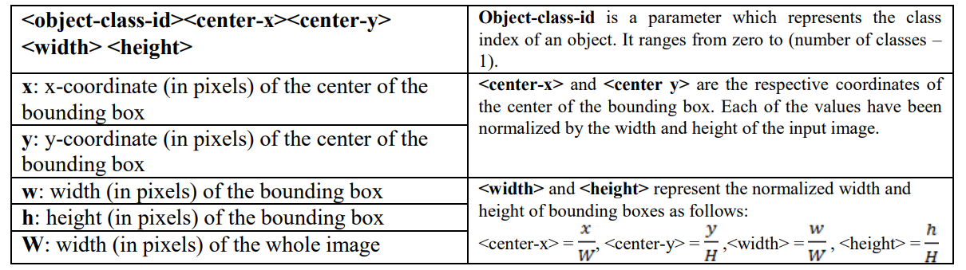

Slide 12
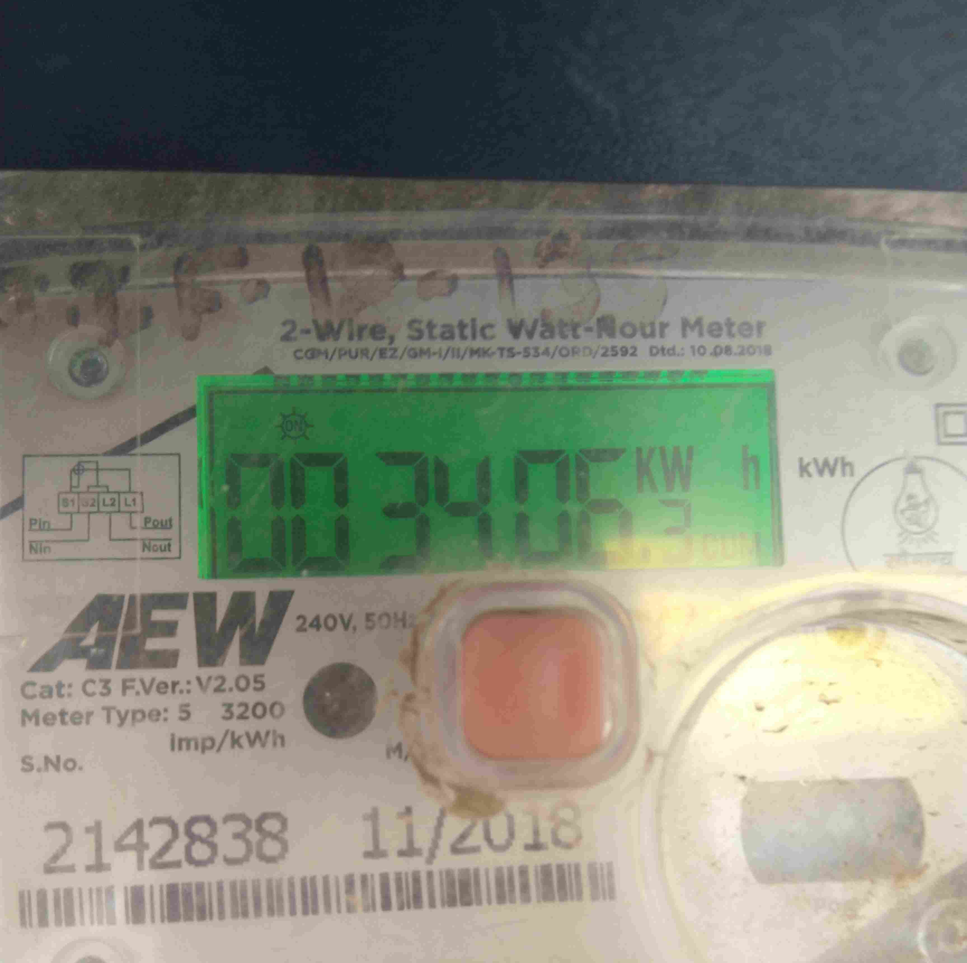
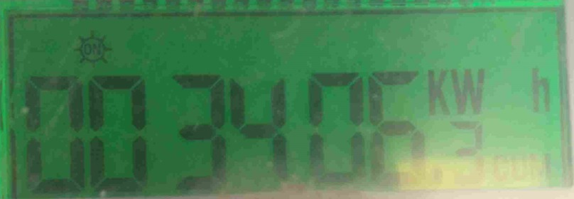
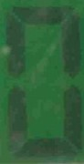
Implementation
YOLO detects number area within an image.
Crop the bounded area.
Preprocessing on the image .
Segmentation to get individual digit.
Run tesseract to get individual character.
Append them together.
We get the number area
0

Slide 13
Setup
First Phase:
Counter Detection
Used 70 image for training and 24 images for testing.
Training took approx. 5 hour to train and saves the best weights file accordingly.
For cropping purpose, I have used custom function by first converting into TensorFlow weight file and then adding custom function

Slide 14
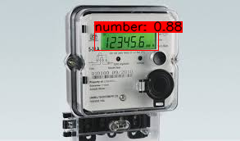
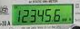
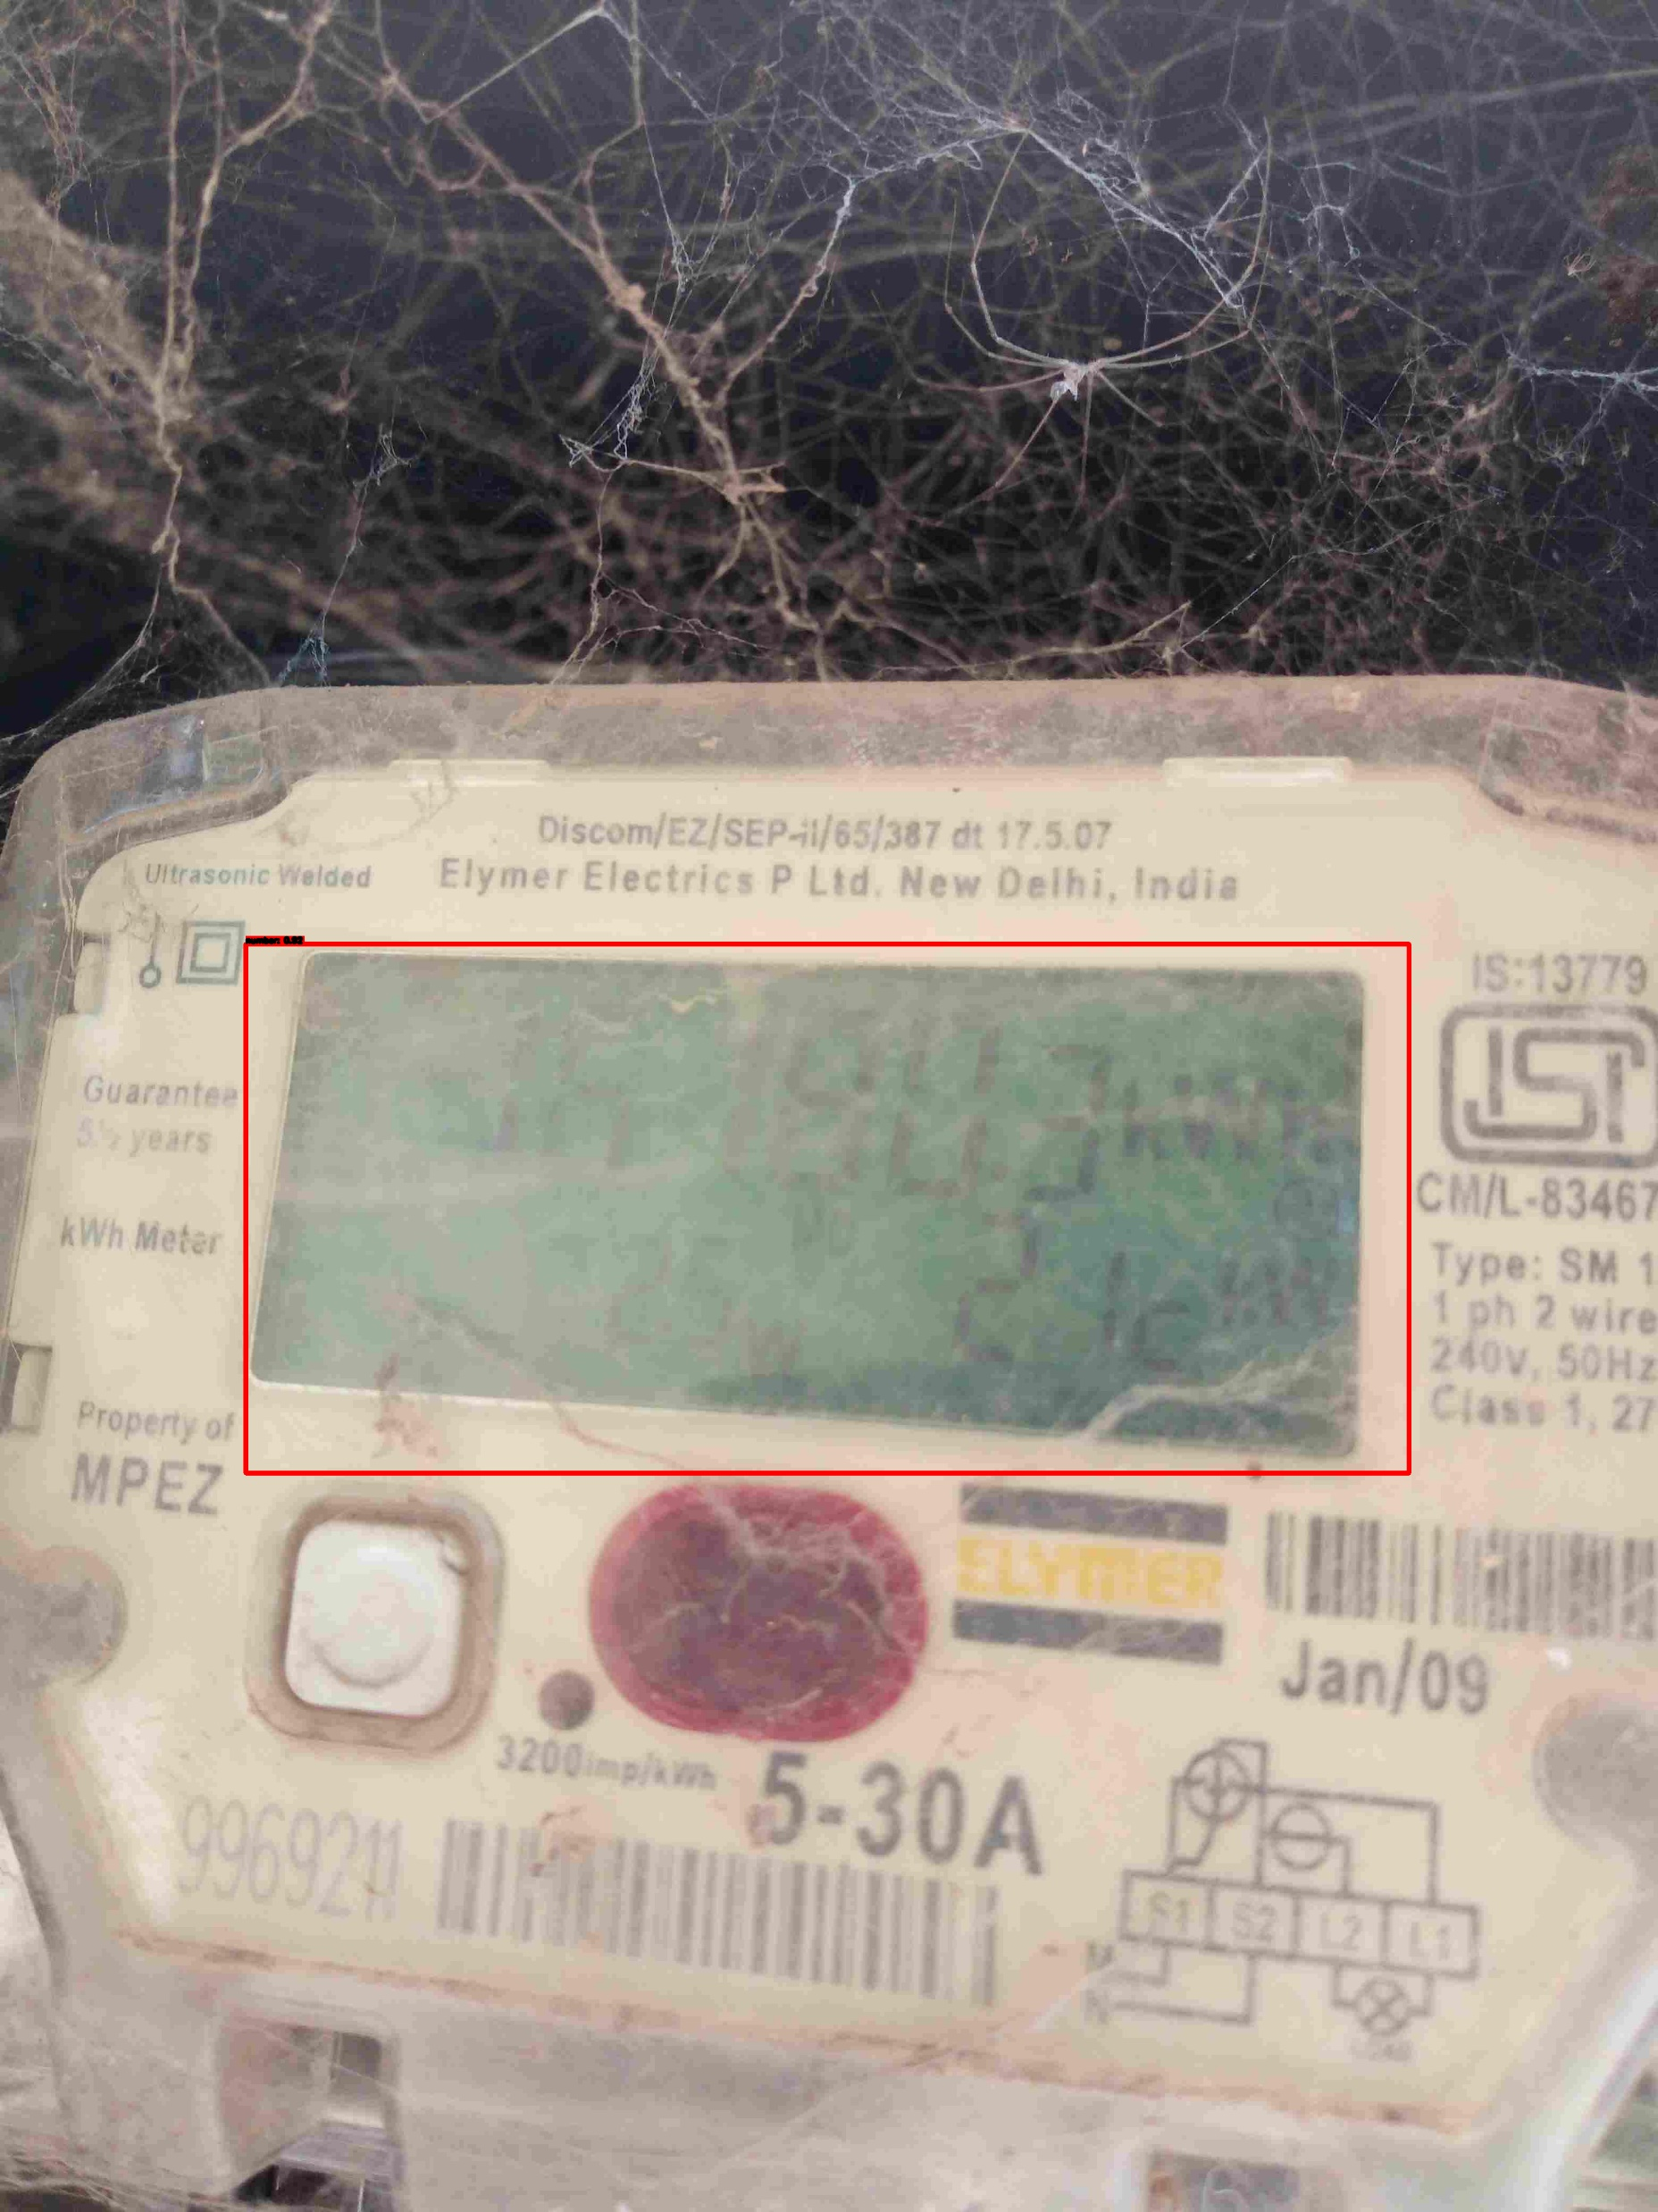
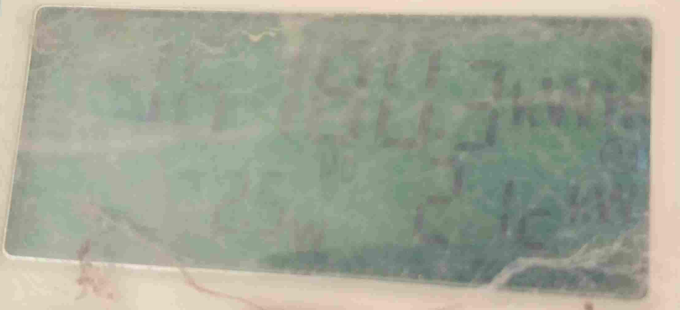
Example:
Notes:
the above examples shows that the model is detecting number area correctlt whether it be a sharp or blur image

Slide 15
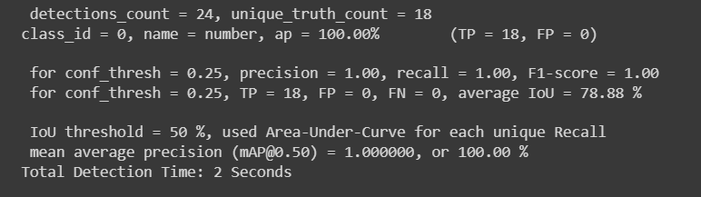
Results
Notes:
Here worth noting that for small training and testing dataset the model performing fairly well as the precision, recall, F1 score are 100%
Where prec and IoU( Intersection over Union) is 78.88%

Slide 16
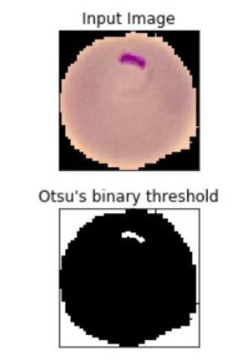
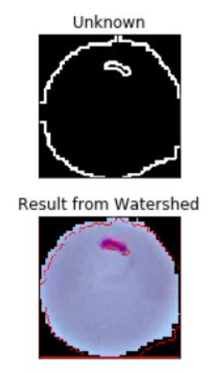
Image Segmentation
The process of splitting images into multiple layers, represented by a smart, pixel-wise mask is known as Image Segmentation. It involves merging, blocking, and separating an image from its integration level.
Image segmentation algorithms like-
- Otsu’s segmentation
- Edge-based segmentation algorithms
- Region-based segmentation algorithms - Clustering-based segmentation algorithms - Neural networks for segmentation
- Watershed segmentation algorithms.
Digit Segmentation
Notes:
Next step in my project is digit segmentation and digit recognition
Image Segmentation helps to obtain the region of interest (ROI) from the image
It is done based on the image properties like similarity, discontinuity

Slide 17
Digit Recognition
The process of identifying the individual digit using the machine learning algorithms is known as Digit Recognition.
In this the OCR model is trained to predict 10 classes (i.e., 0-9) using the cropped counter patch as well as the class and bounding box (x, y, w, h) of each digit as inputs.
[ 0 7 6 2 9 ]
[ 1 1 1 8 ]
Notes:
In this we use the segmented part of the cropped image

Slide 18
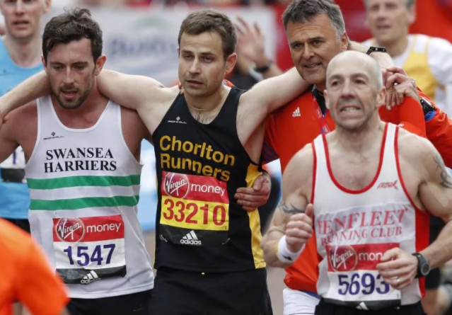
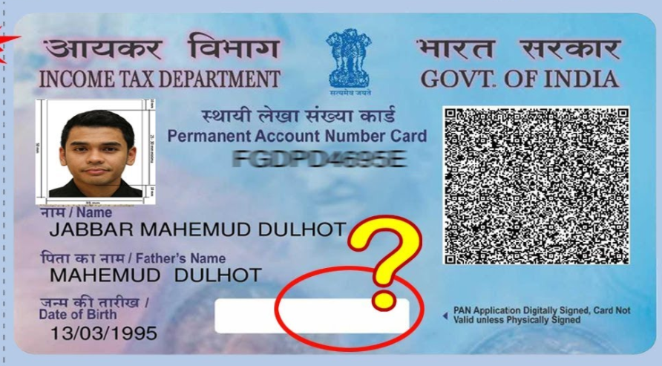
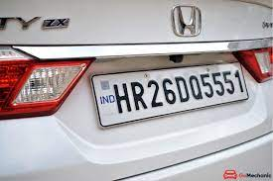
Further Applications
Notes:
Helps in recognizing Marathon runner bib number thus helps in ranking players and also extend help in security of an event
Automatic KYC by providing valid identity card
Automatic Data Entry
Automatic payment by recognizing car licence plate

Slide 19
Reference
R. Laroca, A. B. Araujo, L. A. Zanlorensi, E. C. De Almeida and D. Menotti, "Towards Image-Based Automatic Meter Reading in Unconstrained Scenarios: A Robust and Efficient Approach," in IEEE Access, vol. 9, pp. 67569-67584, 2021, doi: 10.1109/ACCESS.2021.3077415.
Rayson Laroca, Victor Barroso, Matheus A. Diniz, Gabriel R. Gonçalves, William R. Schwartz, David Menotti, "Convolutional neural networks for automatic meter reading," J. Electron. Imag. 28(1) 013023 (5 February 2019)

Slide 20
Thanks

